Slide 1


1. Categorize Land-use & PV type
Classification considering policy design for PV deployment :
PV technology types (a, b, c) & Land-use types (1-9) as followings;
(a) roof-top PV : (1) Industrial complex, (2) Logistics complex, (3) Residential complex, (4) Public buildings
(b) ground-mounted PV : (5) Mountainous area, (6) Farmland, (7) Parking lot, (8) Roadside land
(c) floating PV : (9) Water
Scenario
2. Explore PV-available sites
No Setback
Setback
(GIS-based approach) Exploration of individual potential sites by the nine land-use types
(Geographical constraint)
Slope : (Mountainous area) below 15˚
Protected Area : (Farmland) 농업보호구역, 농업진흥지역; (Mountainous area) 보전산지
Setback distance : All land-use types; different policy by cities and counties
Scenario
No Regulation
All is available
3. Calculate PV potential
Regulation
내용입력 : 내용을 입력해주세요
Parameters based on observed PV installation sites data.
Ratio : Area covered by PV panel to the total area (%)
Coefficient : Required area(m²) to install PV (1kW)
Capacity factor : The ratio of the expected annual average energy production
to the annual energy production assuming the plant operates at its rated capacity
every hour of the year (%)
4. Derive supply curve for PV
LCOE by cities and counties
LCOE by PV technology types
Equation

Slide 2
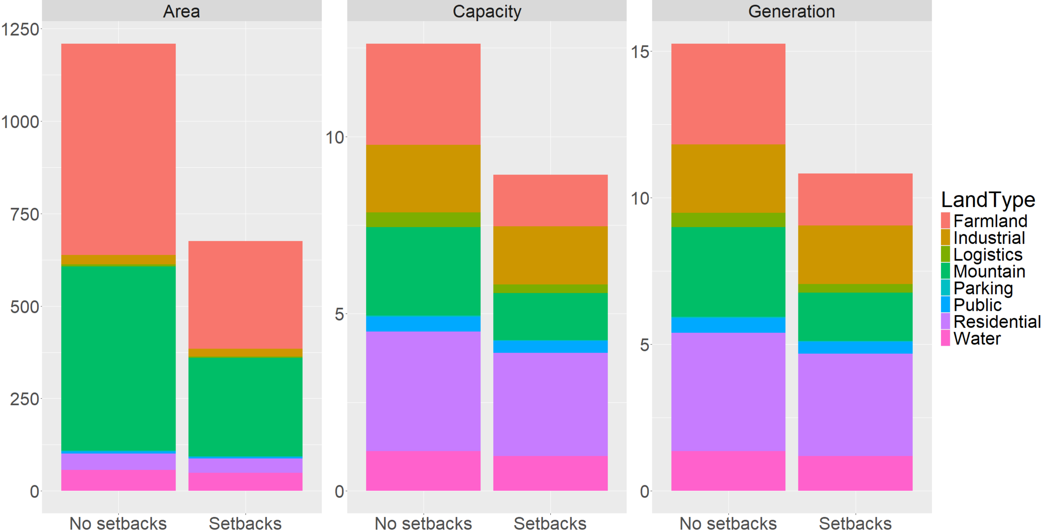
(km²)
(GW)
(TWh)

Slide 3
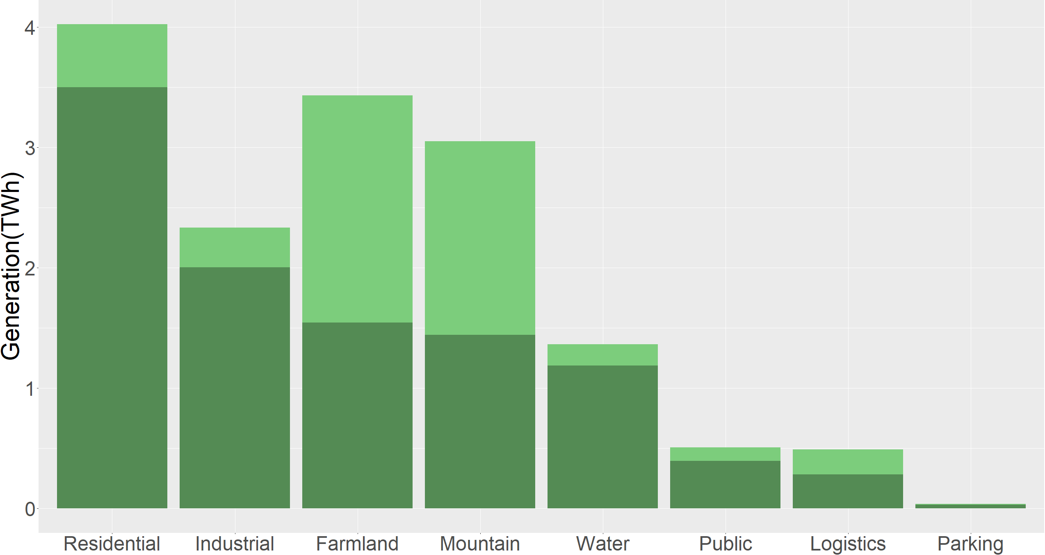
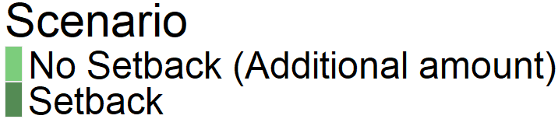

Slide 4
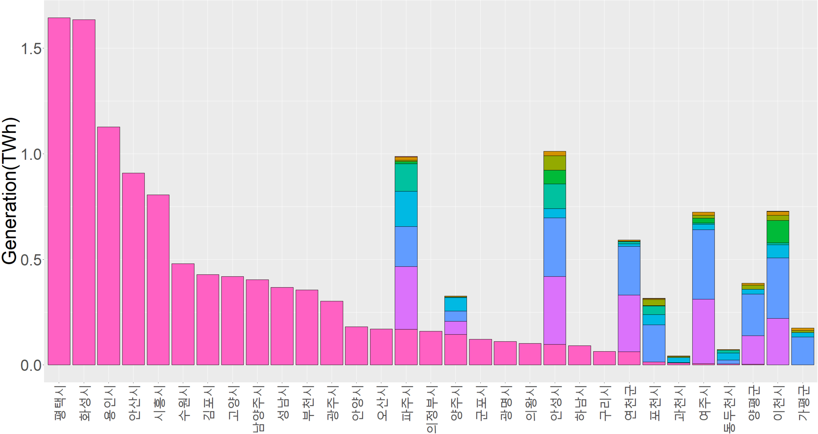

Slide 5
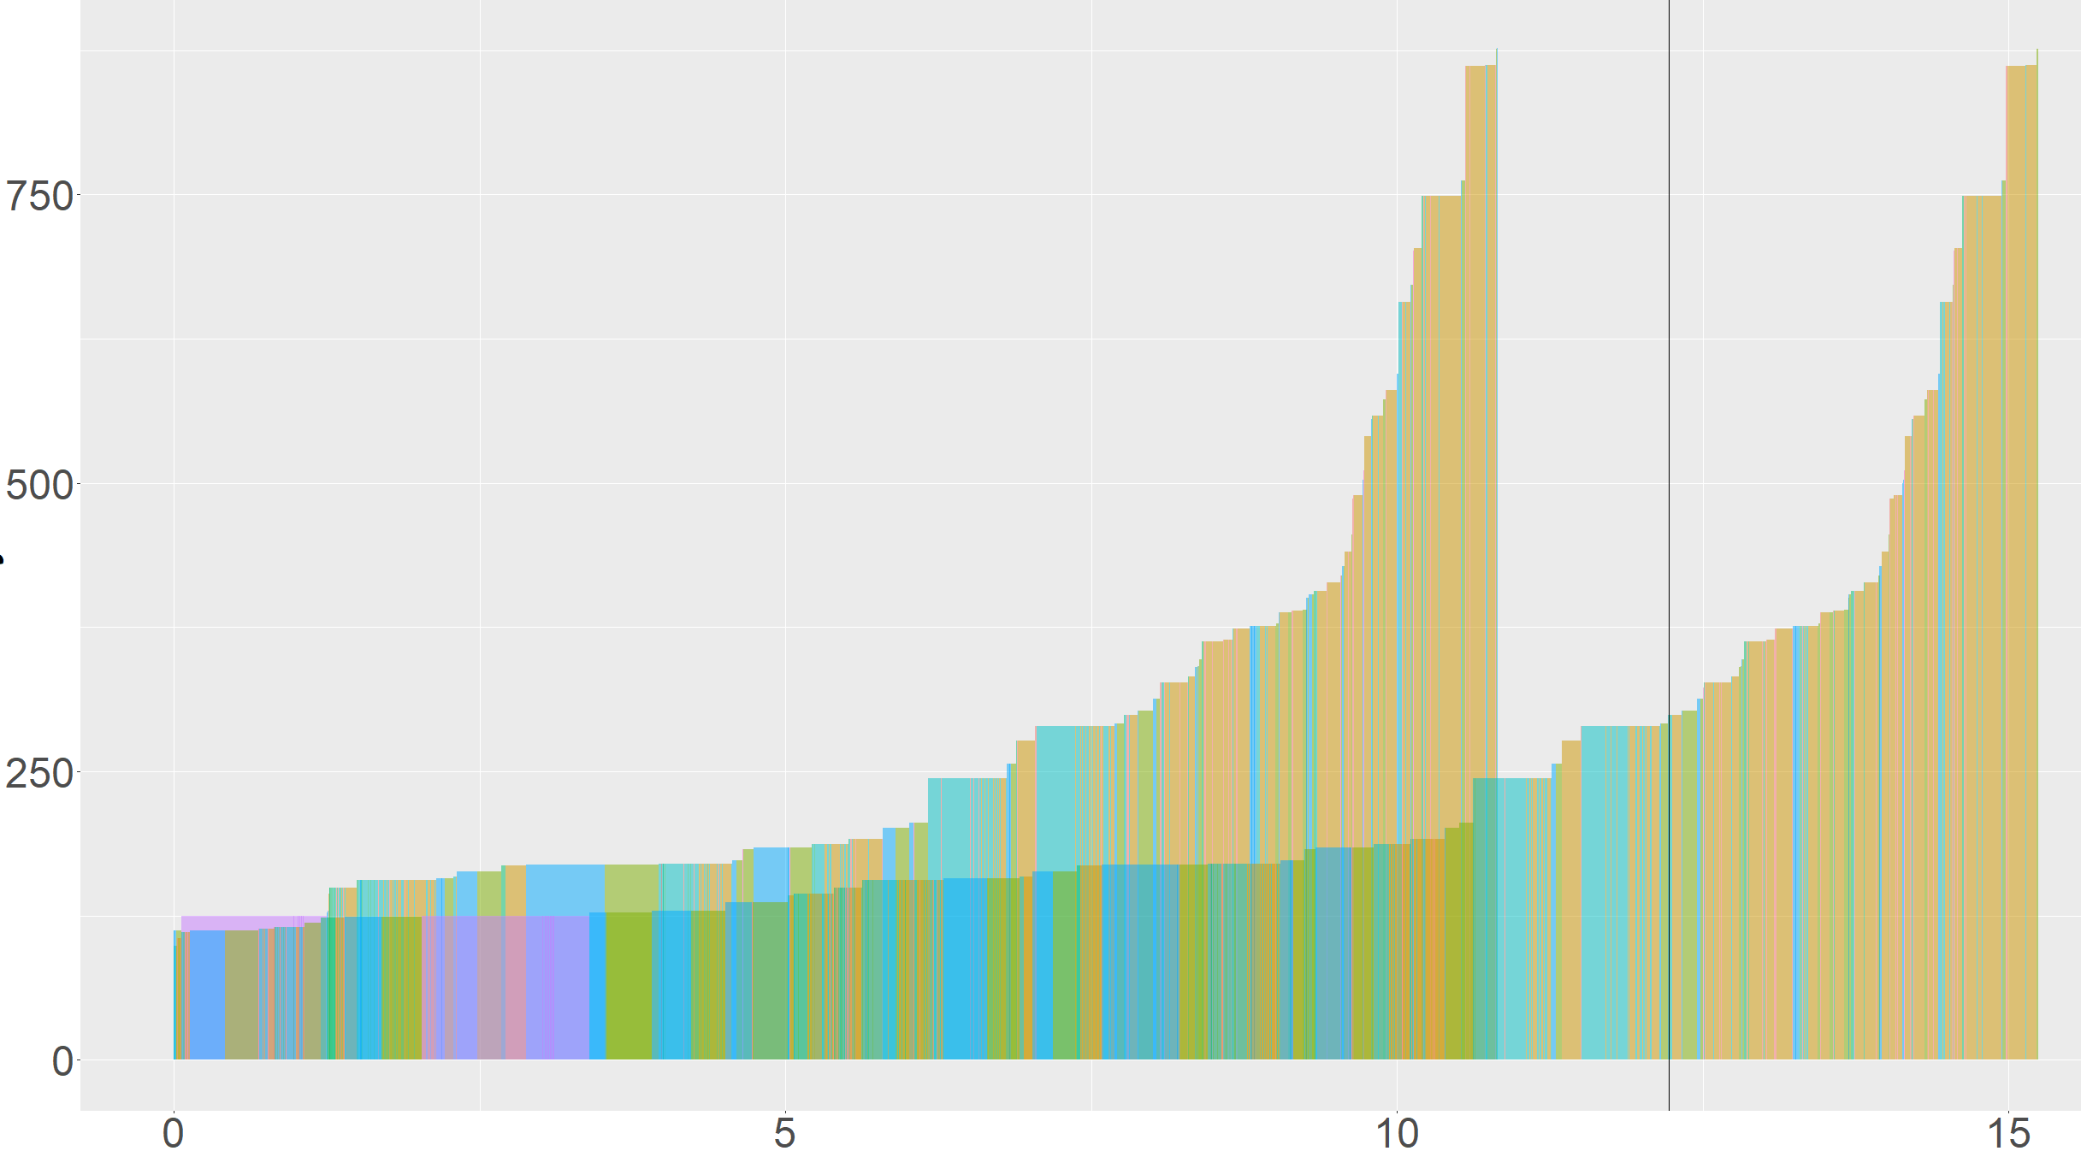


Slide 6
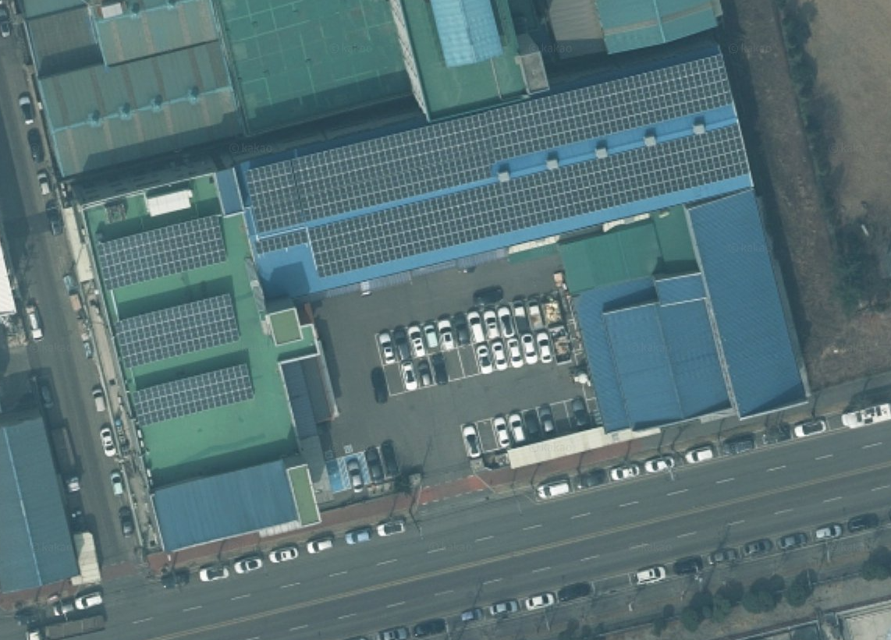


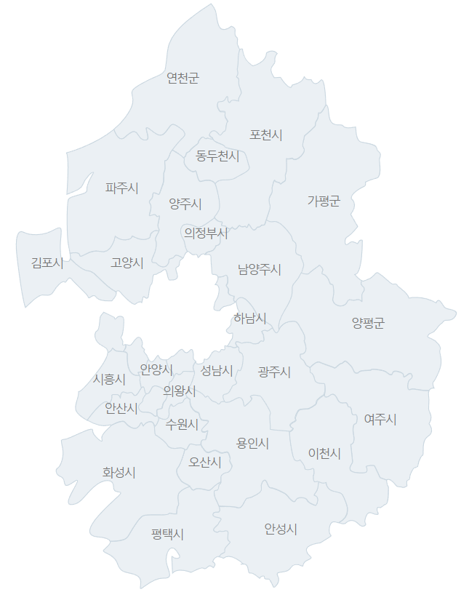




(a)
Total area of the rooftop : 3,300 (m²)
PV installation area : 2,100 (m²)
PV capacity : 348 (kW)
(b)
$$a_{i,j,k,l}$$
=
3,300 (m²)
(c)
= 2,100 (m²)
$${ r}_{l}^{lu}$$
=
=
64 (%)
= 3,300 (m²)
(d)
= 2,100 (m²)
$$r_{k}^{lc}$$
=
6.03 (m²/kW)
= 348 (kW)
(e)
$${cf}_{j}$$
=
14.9 (%)

Slide 7


(a)
(b)
= 2,100 (m²)
$${ r}_{l}^{lu}$$
=
=
0.64
= 3,300 (m²)
(c)
= 2,100 (m²)
$$r_{k}^{lc}$$
=
6.03 (m²/kW)
= 348 (kW)

Slide 8
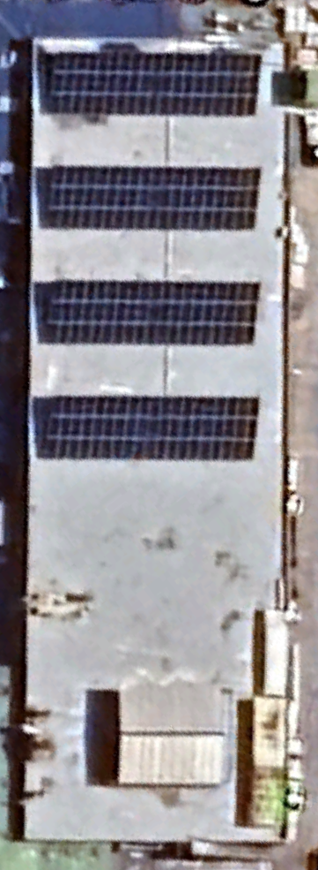
경기 시흥시 옥구천서로131번길 15 시화단지 1라 503호(정왕동)
(a)
(b)

Slide 9
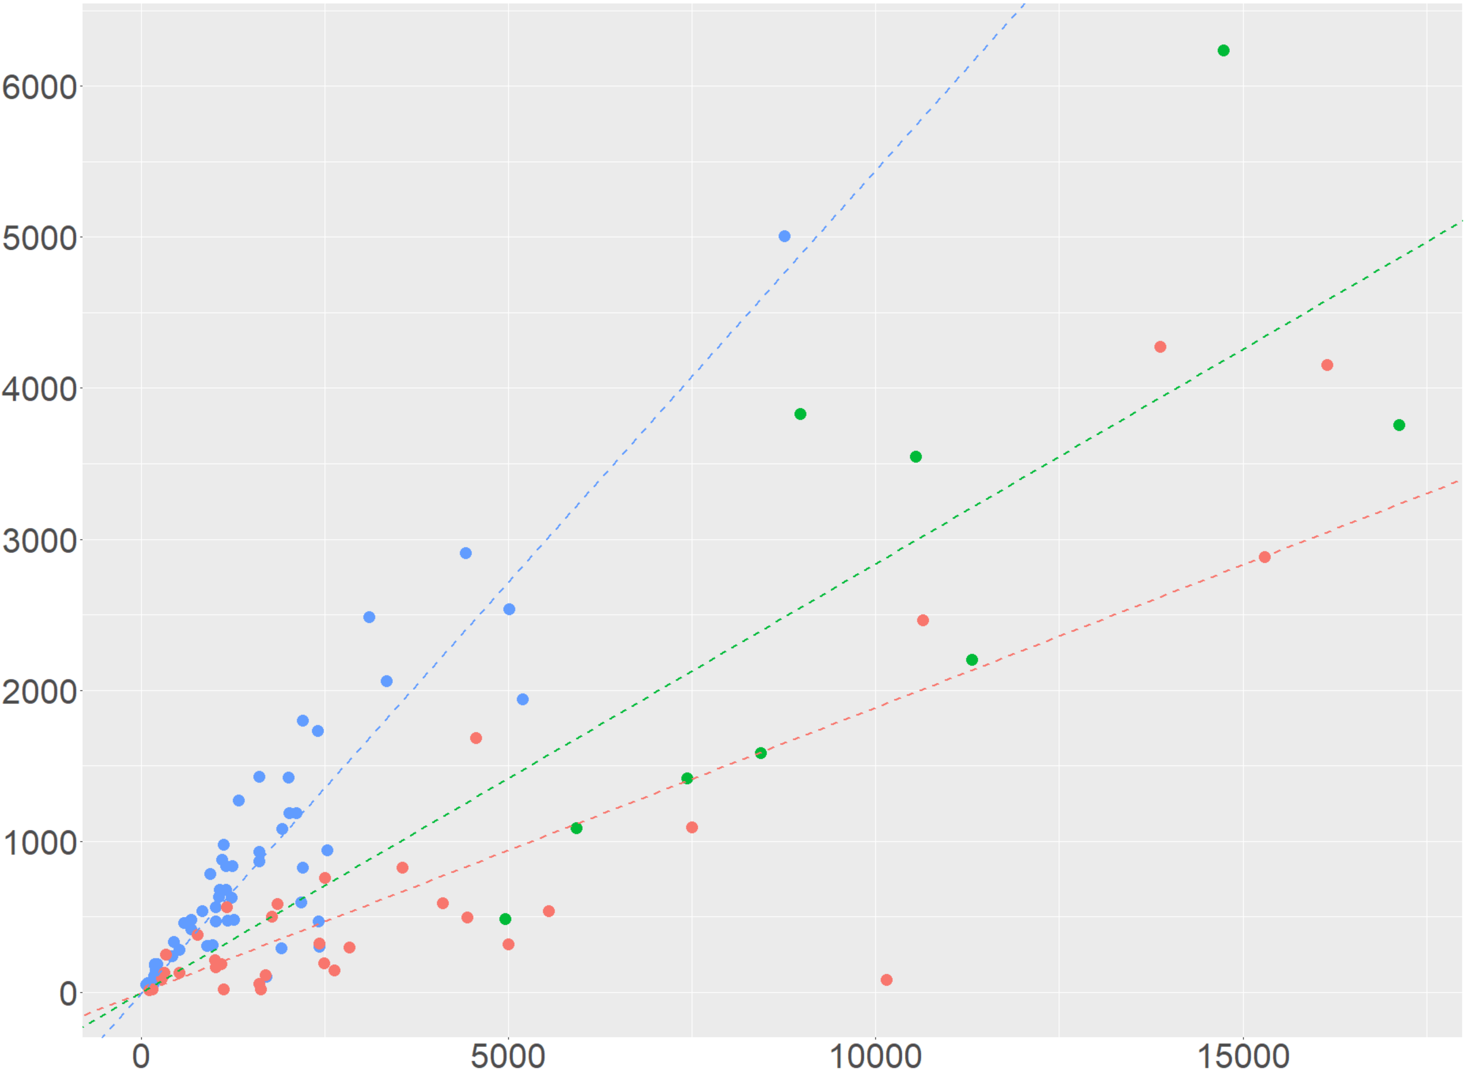
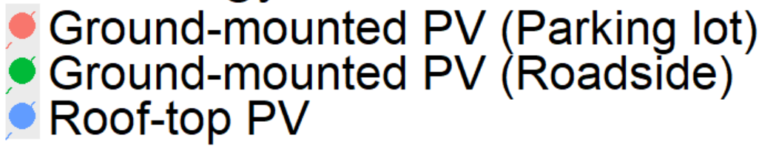
Slope : 0.545
PV installation area (m²)
Slope : 0.284
Slope : 0.189
Total area (m²)

Slide 10
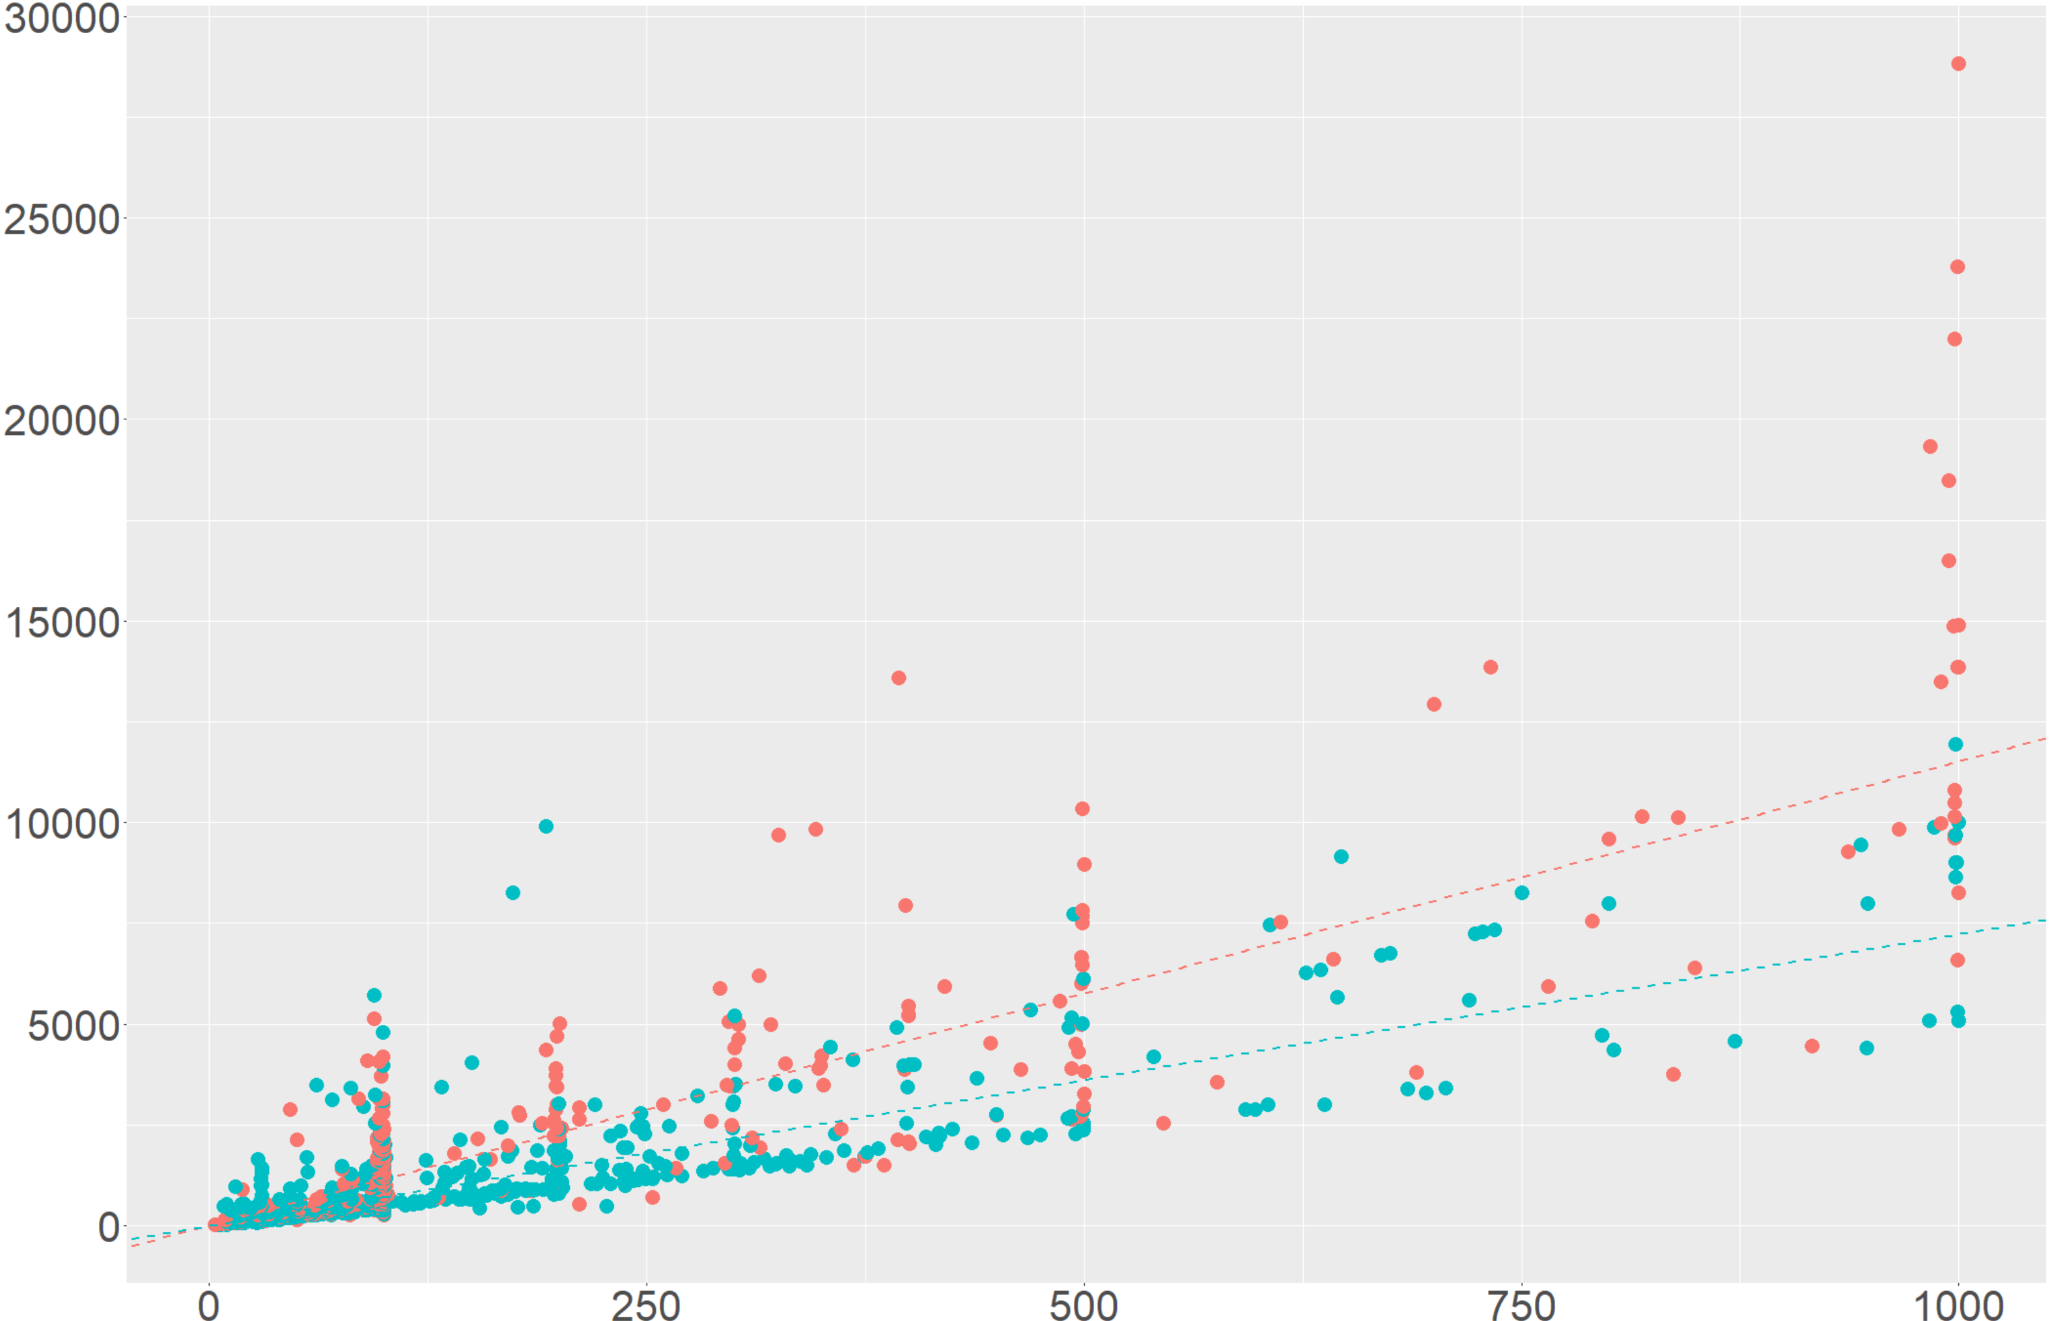

PV installation Area (m²)
Slope : 11.50
Slope : 7.23
Installed capacity of PV (kW)

Slide 11
Categorize Land-use & PV technology Type
Classification considering policy design for PV deployment:
Land-use types : (1) Industrial complex, (2) Logistics complex, (3) Residential complex, (4) Public buildings, (5) Mountainous area, (6) Farmland, (7) Parking lot, (8) Roadside land, (9) Water
PV technology types: (1-4) roof-top PV, (5-8) ground-mounted PV, (9) floating
Geographical constraint
Slope, Protected Area, Setback distance
GIS-based approach
Exploration of individual potential sites in Gyeonggi province by the nine land-use types
Slope, Protected Area, Setback distance
Calculation parameter
Parameters calculated using observed PV sites data.
(1) Ratio : Area covered by PV panel to the total area (%)
(2) Coefficient : Required area(m²) to install PV (1kW)
(3) Capacity factor : Expected annual average energy production divided by the annual energy production assuming the plant operates at rated capacity for every hour of the year.
2020
내용을 입력해주세요
내용을 입력해주세요

Slide 12
Categorize Land-use & PV technology Type
Classification considering policy design for PV deployment :
PV technology types (a, b, c) & Land-use types (1-9) as followings;
(a) roof-top PV : (1) Industrial complex, (2) Logistics complex, (3) Residential complex, (4) Public buildings
(b) ground-mounted PV : (5) Mountainous area, (6) Farmland, (7) Parking lot, (8) Roadside land
(c) floating PV : (9) Water
Explore every sites using GIS-based approach
Exploration of individual potential sites in Gyeonggi province by the nine land-use types
Apply geographical constraint
Slope : (Mountainous area) below 15˚
Protected Area : (Farmland) 농업보호구역, 농업진흥지역; (Mountainous area) 보전산지
Setback distance : All land-use types; different policy by cities and counties
Assume parameter
Parameters calculated using observed PV sites data.
(1) Ratio : Area covered by PV panel to the total area (%)
(2) Coefficient : Required area(m²) to install PV (1kW)
(3) Capacity factor : The ratio of the expected annual average energy production
to the annual energy production assuming the plant operates at its rated capacity every hour of the year (%)
Calculate potential for PV
P
LCOE
Parameters calculated using observed PV sites data.
(1) Ratio : Area covered by PV panel to the total area (%)

Slide 13
Categorize Land-use & PV technology Type
Assume parameter for calculating potential
Assume parameter for calculating LCOE
Classification considering policy design for PV deployment :
Parameters calculated using observed PV sites data.
(1) Ratio : Area covered by PV panel to the total area (%)
(2) Coefficient : Required area(m²) to install PV (1kW)
(3) Capacity factor : The ratio of the expected annual average energy production
to the annual energy production assuming the plant operates at its rated capacity
every hour of the year (%)
LCOE by cities and counties
LCOE by PV technology types
PV technology types (a, b, c) & Land-use types (1-9) as followings;
(a) roof-top PV : (1) Industrial complex, (2) Logistics complex, (3) Residential complex, (4) Public buildings
(b) ground-mounted PV : (5) Mountainous area, (6) Farmland, (7) Parking lot, (8) Roadside land
(c) floating PV : (9) Water
Explore every sites using GIS-based approach
Calculate potential for PV
Calculate potential for PV
Exploration of individual potential sites in Gyeonggi province by the nine land-use types
P
P
Apply geographical constraint
Slope : (Mountainous area) below 15˚
Protected Area : (Farmland) 농업보호구역, 농업진흥지역; (Mountainous area) 보전산지
Setback distance : All land-use types; different policy by cities and counties

Slide 14
1. Categorize Land-use & PV type
Classification considering policy design for PV deployment :
PV technology types (a, b, c) & Land-use types (1-9) as followings;
(a) roof-top PV : (1) Industrial complex, (2) Logistics complex, (3) Residential complex, (4) Public buildings
(b) ground-mounted PV : (5) Mountainous area, (6) Farmland, (7) Parking lot, (8) Roadside land
(c) floating PV : (9) Water
2. Explore PV-available sites
2.1 Explore every sites using GIS-based approach
Exploration of individual potential sites in Gyeonggi province by the nine land-use types
2.2 Apply geographical constraint
Slope : (Mountainous area) below 15˚
Protected Area : (Farmland) 농업보호구역, 농업진흥지역; (Mountainous area) 보전산지
Setback distance : All land-use types; different policy by cities and counties
3. Calculate PV potential
3.1 Assume parameter for calculating potential
Parameters calculated using observed roof-top PV sites data.
(1) Ratio : Area covered by PV panel to the total area (%)
(2) Coefficient : Required area(m²) to install PV (1kW)
(3) Capacity factor : The ratio of the expected annual average energy production
to the annual energy production assuming the plant operates at its rated capacity
every hour of the year (%)
3.2 Calculate potential for PV
Equation??
4. Derive supply curve for PV
4.1 Assume parameter for calculating LCOE
LCOE by cities and counties
LCOE by PV technology types
4.1 Assume parameter for calculating LCOE
Equation??

Slide 15
1. Categorize Land-use & PV type
Classification considering policy design for PV deployment :
PV technology types (a, b, c) & Land-use types (1-9) as followings;
(a) roof-top PV : (1) Industrial complex, (2) Logistics complex, (3) Residential complex, (4) Public buildings
(b) ground-mounted PV : (5) Mountainous area, (6) Farmland, (7) Parking lot, (8) Roadside land
(c) floating PV : (9) Water
2. Explore PV-available sites
2.1 Explore every sites using GIS-based approach
Exploration of individual potential sites in Gyeonggi province by the nine land-use types
2.2 Apply geographical constraint
Slope : (Mountainous area) below 15˚
Protected Area : (Farmland) 농업보호구역, 농업진흥지역; (Mountainous area) 보전산지
Setback distance : All land-use types; different policy by cities and counties
3. Calculate PV potential
Parameters calculated using observed PV installation sites data.
(1) Ratio : Area covered by PV panel to the total area (%)
(2) Coefficient : Required area(m²) to install PV (1kW)
(3) Capacity factor : The ratio of the expected annual average energy production
to the annual energy production assuming the plant operates at its rated capacity
every hour of the year (%)
4. Derive supply curve for PV
LCOE by cities and counties
LCOE by PV technology types
Equation

Slide 16
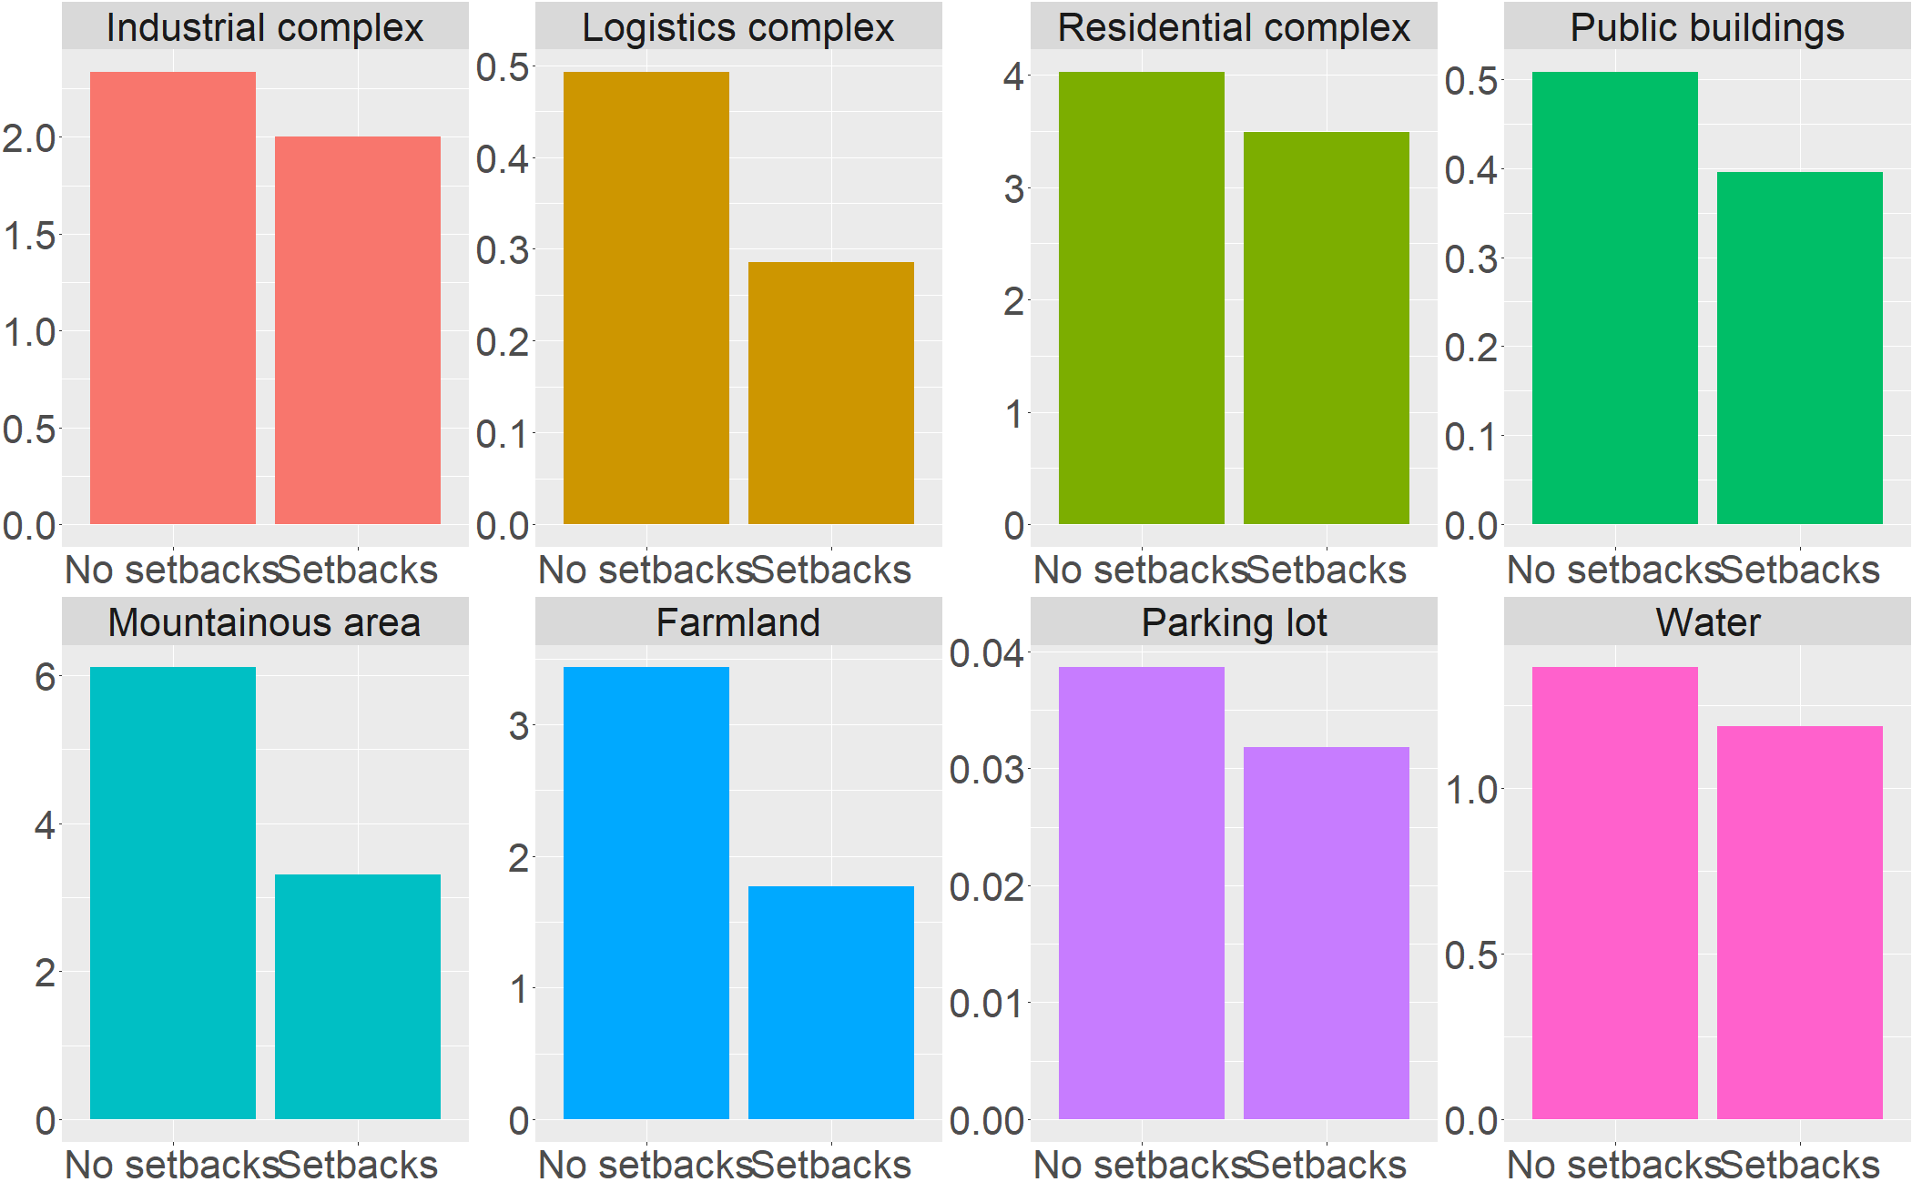
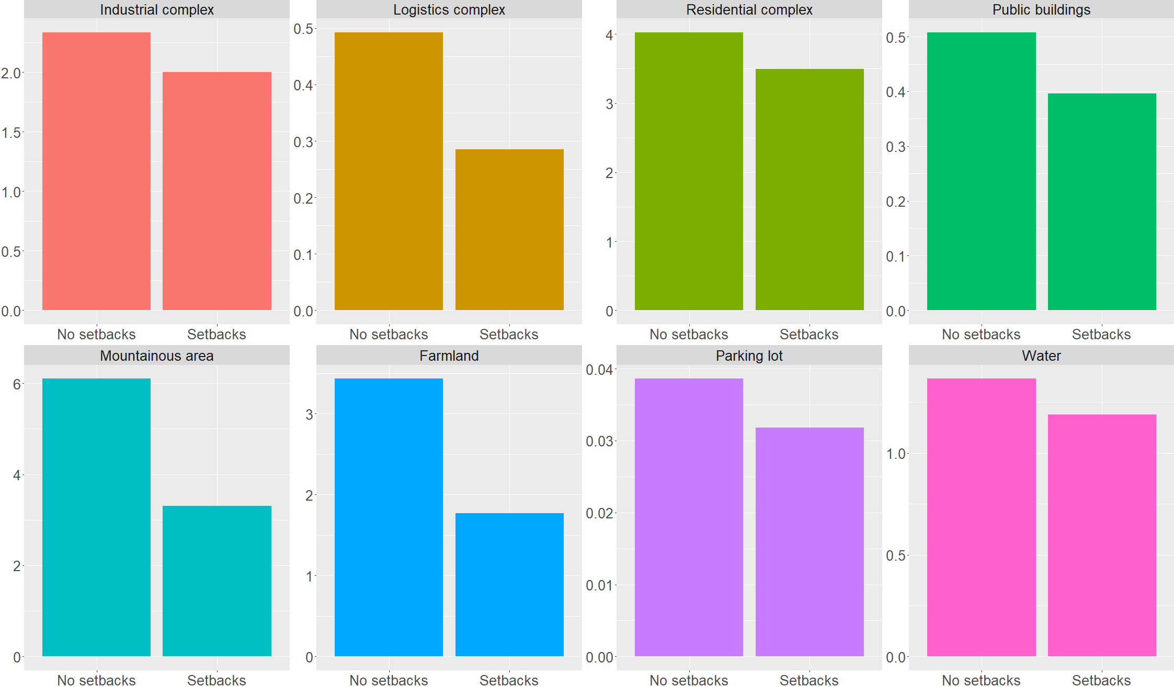
14.2%
42.1%
13.1%
22.0%
45.9%
48.4%
17.7%
12.9%

Slide 17
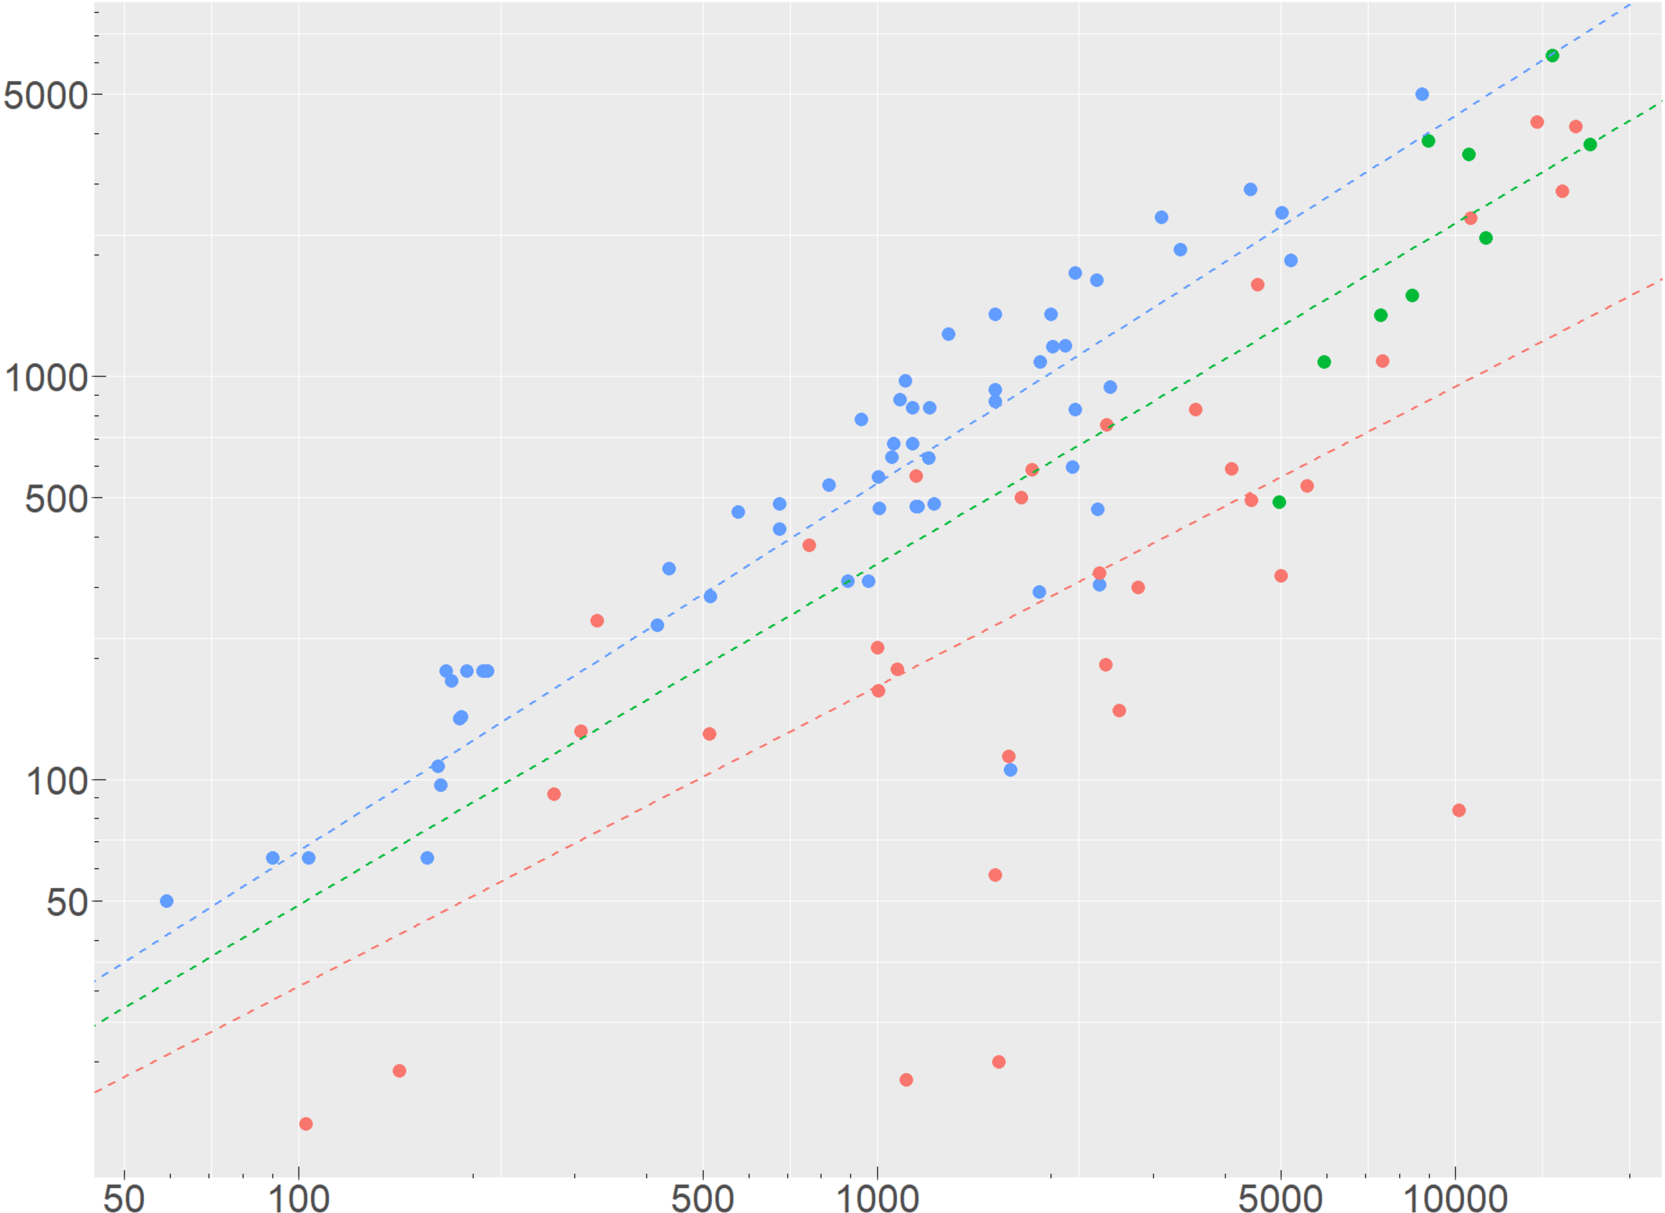
PV installation Area (m²)
Slope : 0.545
Slope : 0.189
Slope : 0.284
Total Area (m²)

Slide 18
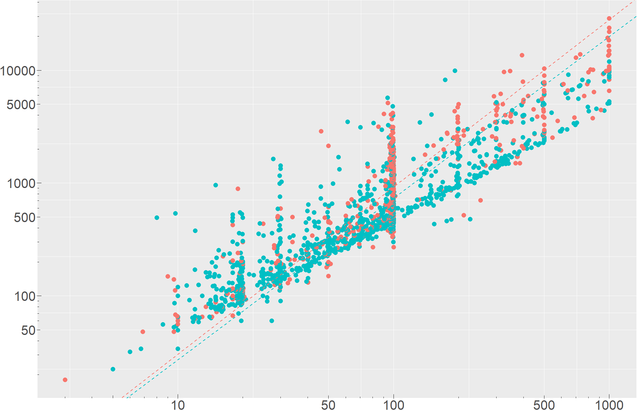
PV installation Area (m²)
Slope : 11.50
Slope : 7.23
Installed capacity of PV (kW)

